Slide 1
Additional Functional Dependencies

Slide 2
How to infer a functional dependency from a set of functional dependency F ?
Given a relation schema R & a set of functional dependency F.
Suppose that X → Y has not been mentioned as a member of F.
Does X → Y hold on R? i.e. Can we infer X → Y from F?
To find it whether X → Y can be inferred from F,
compute X⁺.
If X⁺ contains Y then X → Y can be inferred from F.

Slide 3
Example
Suppose that F is a set of functional dependency defined by
F = {A → C, AC → D, E → AD, E → H}
Is it possible to infer A → CD from F?
We find that A⁺ = ACD and ACD contains CD.
Hence we can infer A → CD from F.
Similarly we can also infer E → AH from F.

Slide 4
Equivalence of sets of functional dependency
To test whether two sets of functional dependency F₁ and F₂ are equivalent it is necessary to show that
(i) every functional dependency of F₂ can be inferred from F₁ and
(ii) every functional dependency of F₁ can be inferred from F₂.

Slide 5
Example
Let R is a relation schema given by R(A, B, C, D)
and two sets of functional dependency specified
on R are
F = {A → B, B → C, AC → D}
G = {A → B, B → C, A → D}
Are F & G equivalent?
To determine their equivalence, we need to prove that F+ = G+.
Let us see if we can infer all FDs in F using G;
Take the attributes from the LHS of FDs in F and compute attribute closure for each using FDs in G:
A+ using G = ABCD; A -> A; A -> B; A -> C; A -> D;
B+ using G = BC; B -> B; B -> C;
AC+ using G = ABCD; AC -> A; AC -> B; AC -> C; AC -> D;
Notice that all FDs in F (highlighted) can be inferred using FDs in G.
To see if all FDs in G are inferred by F, compute attribute closure for attributes on the LHS of FDs in G using FDs in F:
A+ using F = ABCD; A -> A; A -> B; A -> C; A-> D;
B+ using F = BC; B -> B; B -> C;
Since all FDs in F can be obtained from G and vice versa, we conclude that F and G are equivalent

Slide 6
Alternative definition
Two sets of functional dependencies F and G are said to be equal if;
F can cover G, and G can cover F.
Example:
Let R (A, B, C, D, E) be a relation with set of functional dependencies
F = { A → BC, A → D, CD → E } and G = { A → BCE, A → ABD, CD → E }. Is F = G?
Does F cover G?
If set of FDs of G can be inferred from F, then we would say that F covers G.
The FD A → BCE of G can be inferred from the FDs A → BC, A → D, and CD → E of F. [here, A gives BCD. If you know C and D then E can be derived]
The FD A → ABD of G can be inferred from the FDs A → BC, and A → D of F.
The FD CD → E of G can be inferred from the FD CD → E of F.
All the three FDs of G can be inferred from FDs of F. Hence, F covers G.
Does G cover F?
If set of FDs of F can be inferred from G, then we would say that G covers F.
The FD A → BC of F can be inferred from the FD A → BCE of G.
The FD A → D of F can be inferred from the FD A → ABD of G.
The FD CD → E of F can be inferred from the FD CD → E of G.
All the three FDs of F can be inferred from FDs of G. Hence, G covers F.
Hence, we would say F is equivalent to G.

Slide 7
Canonical form of a functional dependency
A functional dependency X → Y is said to be in canonical form if the right hand side of the functional dependency contains only one attribute.
For example, if R(A, B, C, D, E) then the functional dependency AB → C is in canonical form, so also E → D.

Slide 8
Minimal cover
A set of functional dependencies G specified on a schema R is said to be a Minimal cover of another set of functional dependencies F defined on the same schema R
If all functional dependencies of G are in canonical form.
No functional dependency of G has extraneous attribute.
No functional dependency can be removed from G.
G is equivalent to F.

Slide 9
Minimal cover
Logic for Minimal Cover
Needs single attribute on the RHS in all FDs,
Need to look for extraneous (redundant) attributes on the LHS and also look for FDs that are redundant.
Extraneous Attributes
Apply either of the rules below to find extraneous attributes on the LHS:
1. In an FD {α→β} from set F, attribute A ε α is extraneous in α
if F logically implies (F – {α→β}) ⋃ {(α– A) → β}.
2. To test if attribute A ε α is extraneous in α
Step 1: compute ({α} – A)+ using the dependencies in F
Step 2: check that ({α} – A)+ contains A; if it does, A is extraneous

Slide 10
Example -1 for Minimal Cover
F = { AB -> C, C -> A, BC -> D, ACD -> B, D -> E, D -> G, BE -> C, CG -> B, CG -> D, CE -> A, CE -> G}
Consider ACD -> B to see if any of the three attributes on the LHS is extraneous.
Start with A.
Applying Rule 2, we need to compute ({ACD} – A)+ using the dependencies in F and check if the result contains A; if it does, attribute A is extraneous.
Computing CD+, we get ACDEGB which contains A and therefore, A is extraneous.
Also the closure contains B, which tells us that CD -> B holds.

Slide 11
Example - 2
Let us apply these properties to F = {A → C, AB → C, C → DI, CD → I, EC → AB, EI → C}
1. Right Hand Side (RHS) of all FDs should be single attribute. So we write F as F1, as follows;
F1 = {A → C, AB → C, C → D, C → I, CD → I, EC → A, EC → B, EI → C}
2. Remove extraneous attributes.
Extraneous attribute is a redundant attribute on the LHS of the functional dependency.
In the set of FDs, AB → C, CD → I, EC → A, EC → B, and EI → C have more than one attribute in the LHS.
Hence, we check one of these LHS attributes are extraneous or not.
To check, we need to find the closure of each attribute on the LHS; [apply the closure finding algorithm – refer here]
(i) A+ = ACDI
(ii) B+ = B
(iii) C+ = CDI
(iv) D+ = D
(v) E+ = E
(vi) I+ = I
From (i), the closure of A included the attribute C. So, B is extraneous in AB → C, and B can be removed.
From (iii), the closure of C included the attribute I. So, D is extraneous in CD → I, and D can be removed.
No more extraneous attributes are found. Hence, we write F1 as F2 after removing extraneous attributes from F1 as follows;
F2 = {A → C, C → D, C → I, EC → A, EC → B, EI → C}

Slide 12
Example - 3
The set F = {A → BC, B → C, A → B, AB → C}
is reduced to
F = {A → B, A → C, B → C, AB → C}
(by converting all functional dependencies into canonical form).
We also find that B can be removed from the left hand side of AB → C.
So F = {A → B, B → C, A → C}
But A → C can be inferred from {A → B, B → C},
And we get G = {A → B, B → C}.

Slide 13
Example - 4
Find a minimal cover of
F = {B→A, D→ A, AB → D}.
[Answer: G = {D → A, B → D} ]
Find a minimal cover of
F = {A → B, B → C, AC → D}.
[Answer: G = {A → B, B → C, A → D}]

Slide 14
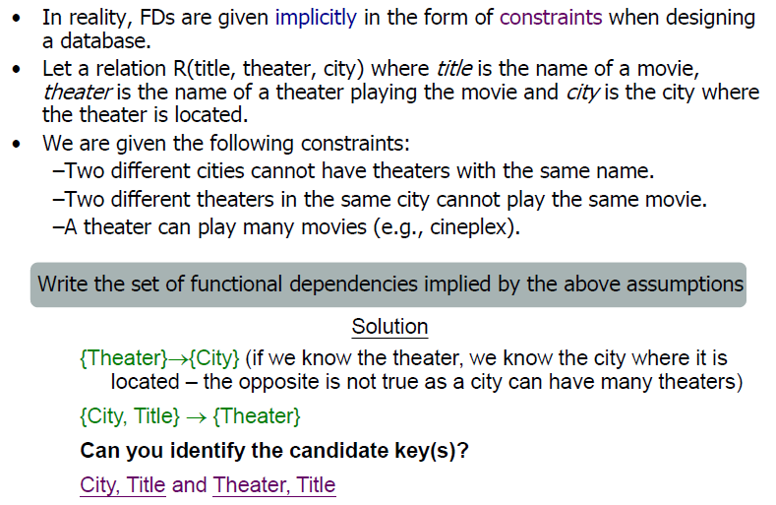

Slide 15
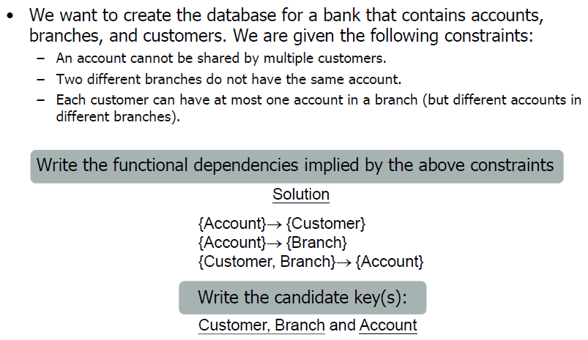

Slide 16
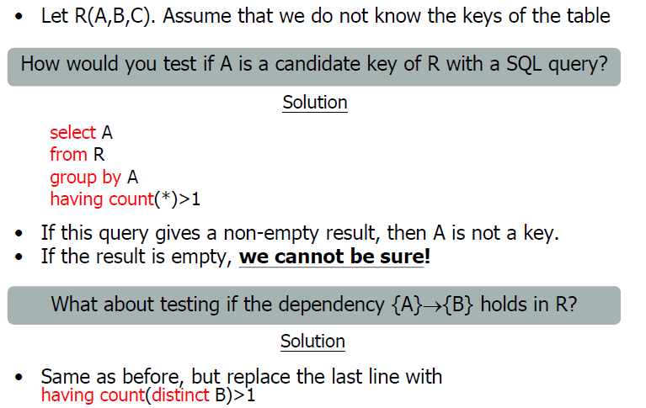

Slide 17
